Slide 1


Work-Study Counter
Work-Study Counter
Gandy Mendieta - Juan Torres - Daniel Rodriguez

Slide 2


Slide 3
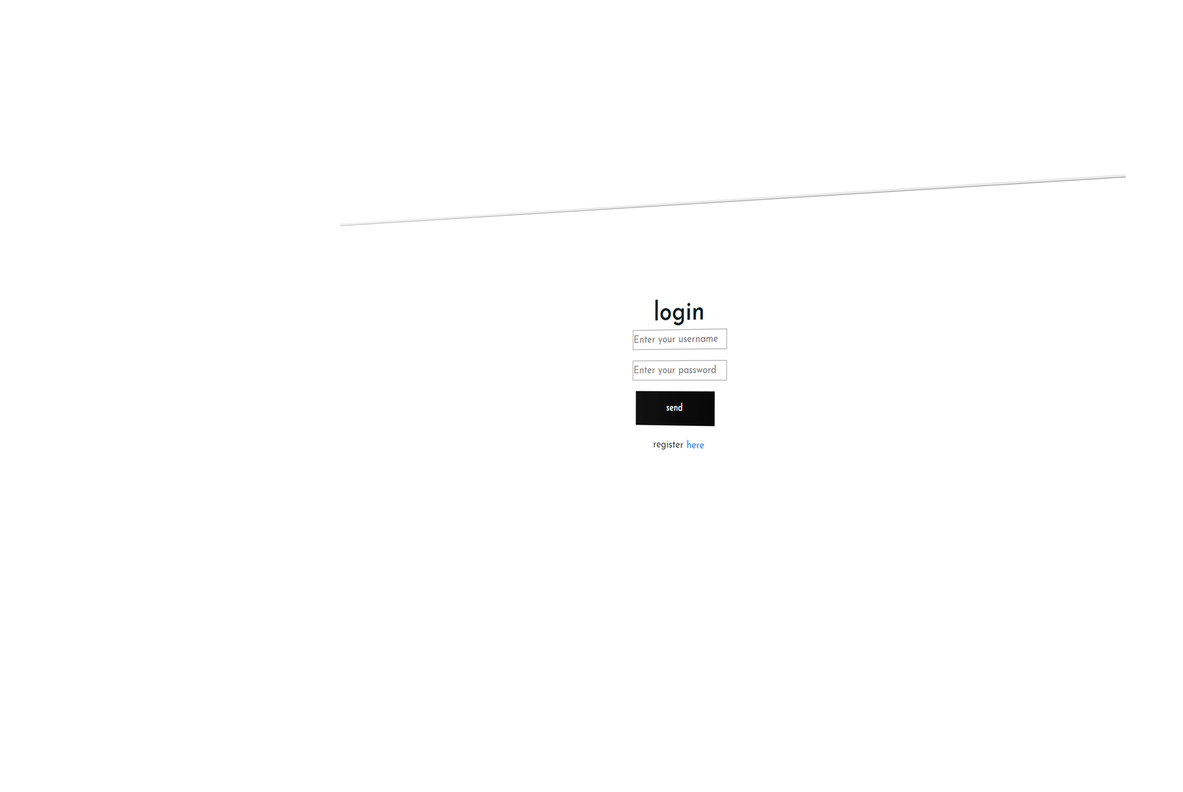



Doing an efficient work

Slide 4
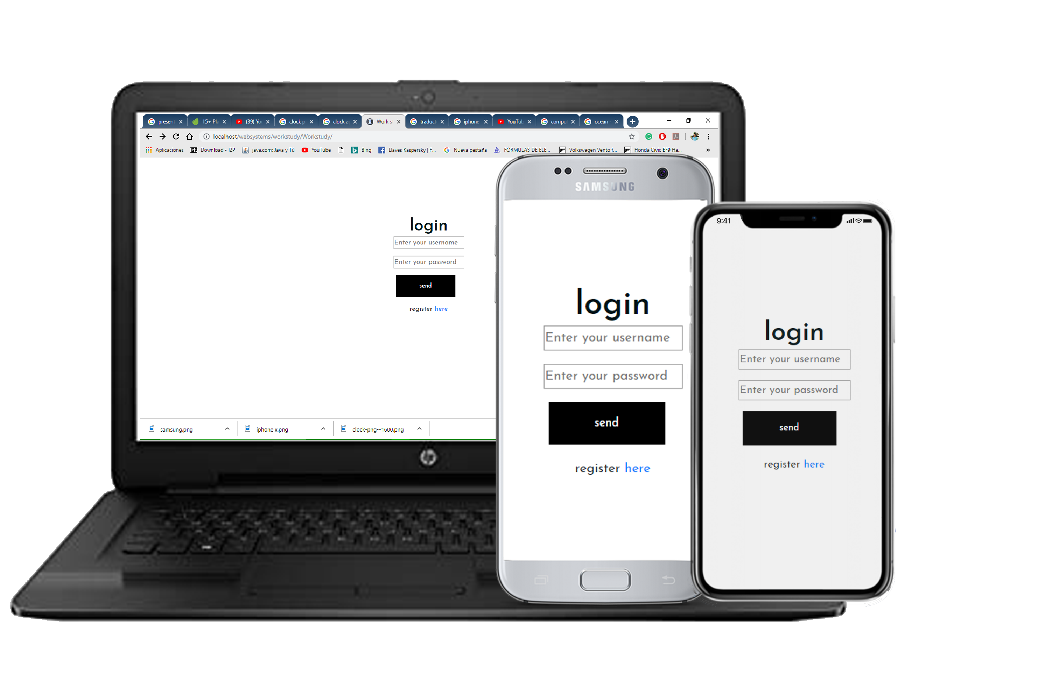
Multiplatform
Available in:
Android
Apple
Windows

Slide 5
Benefits of using this WSC
Better control- Less time spent - easy access – easy to use- minimalist interface

Slide 6
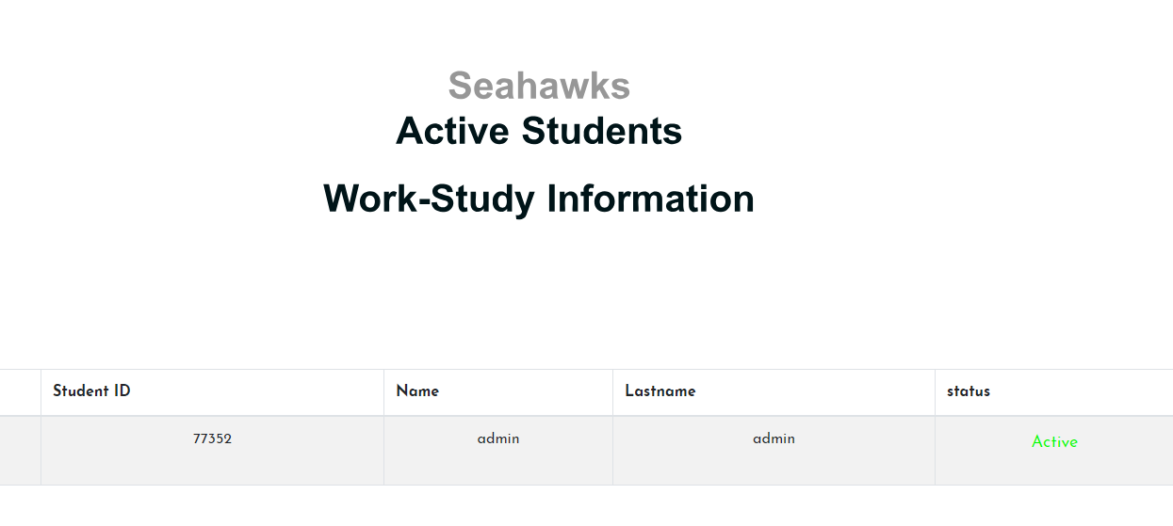
Windows to see active students

Slide 7
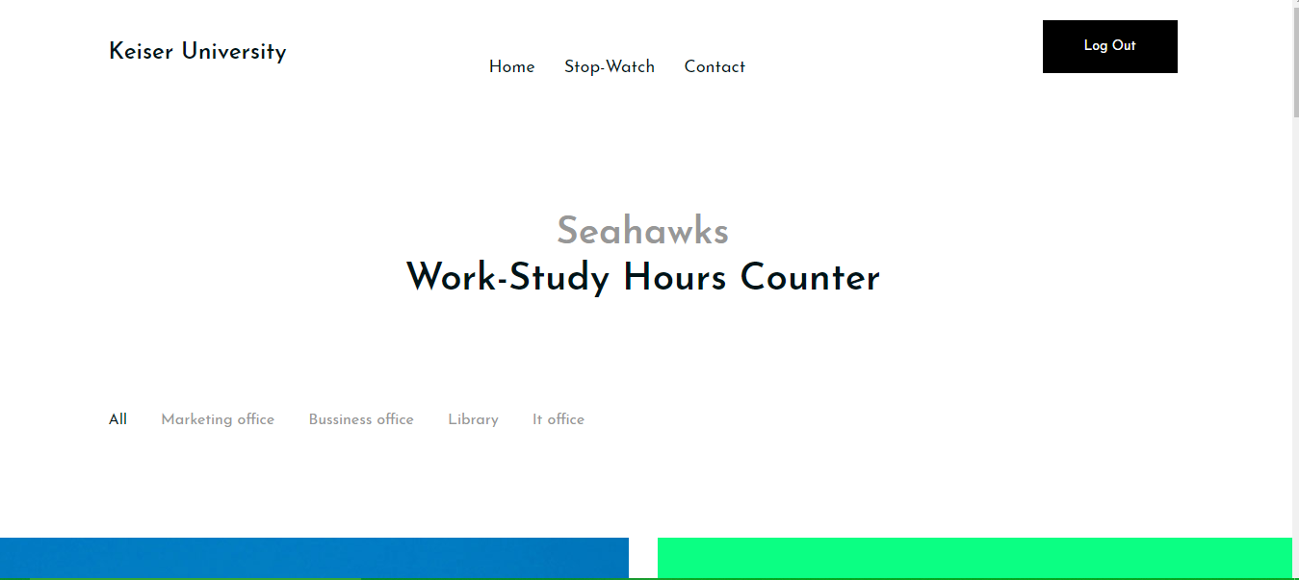
Newsletter
Where students can look for a Job vacancy

Slide 8
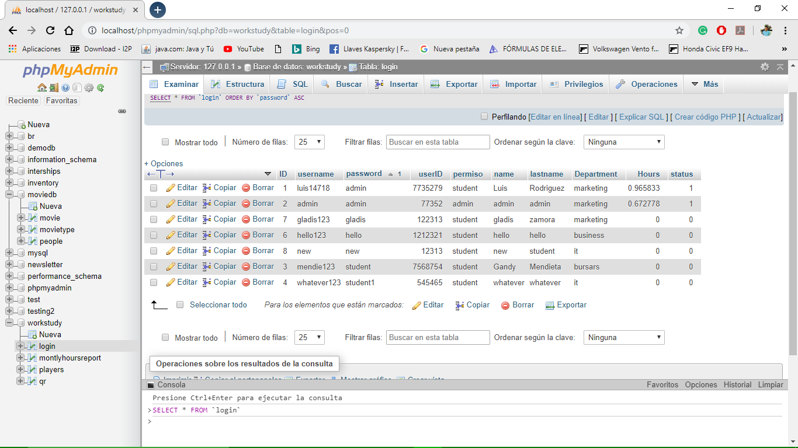

Slide 9
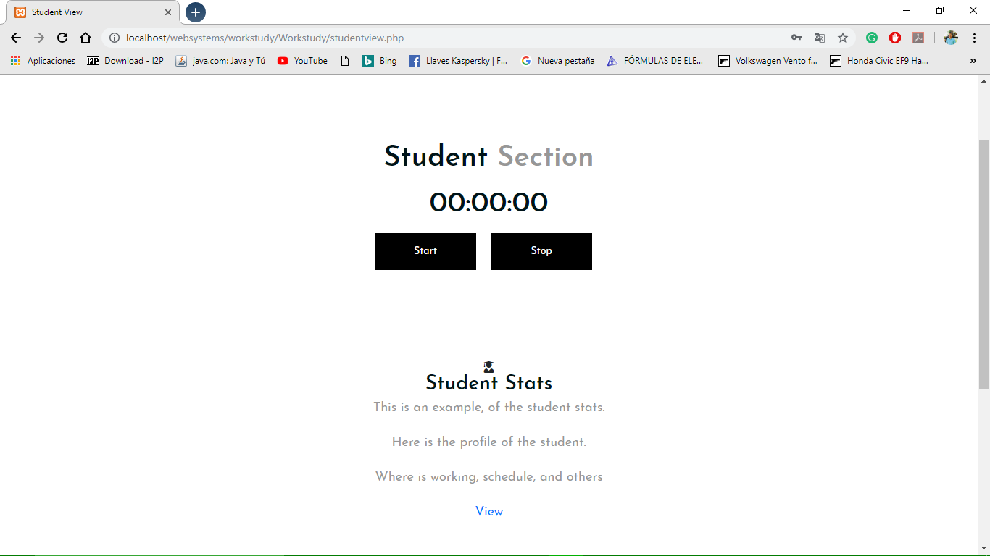
Be connected where ever you are
It is not necessary to bring
the work study sheets to
the office. Automatically,
The reports are sent to
Human Resources

Slide 10
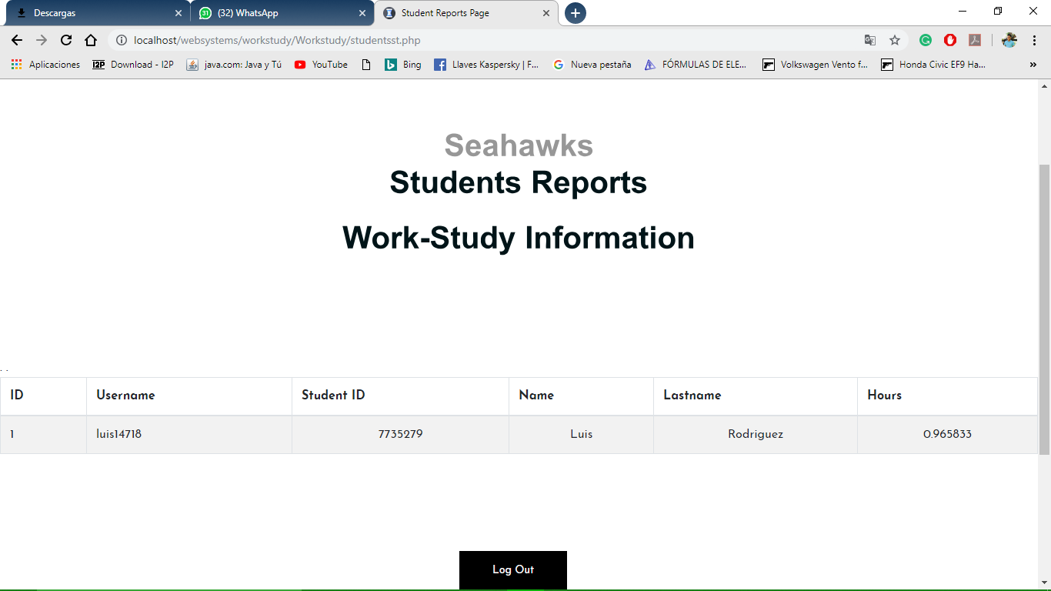
Student Report Student view

Slide 11
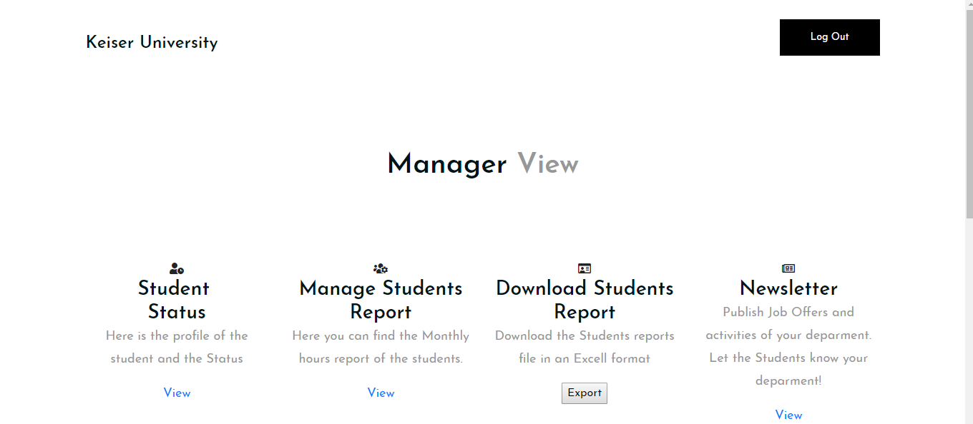
Excellent view for administrator

Slide 12
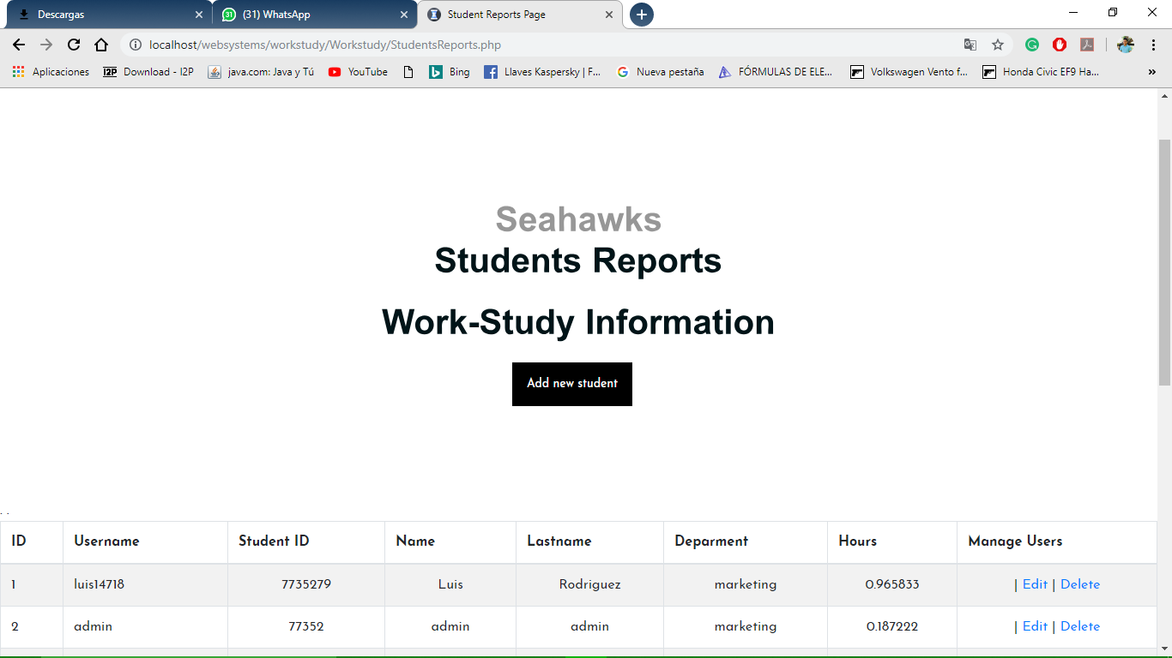
Student Report

Slide 13

Get ready for whats next

